Slide 1
Build serverless, full stack applications in Azure https://aka.ms/azuremodernapps
Speaker/title
Notes:
Anna then Davide introduce

Slide 2

Build serverless, full stack applications in Azure New learning path with free Azure sandbox
Architect
Architect modern applications using Azure SQL Database
Deploy
Deploy serverless APIs with Azure Functions, Logic Apps, and Azure SQL Database
Build
Build full stack applications with Azure Static Web Apps and Azure SQL Database
Automate
Architect full stack applications and automate deployments with GitHub
aka.ms/AzureModernApps
Notes:
Anna
Learn how to create, build, and deploy modern full stack applications in Azure by using the language of your choice (Python, Node.js, or .NET) and with a Vue.js frontend. Topics covered include modern database capabilities, CI/CD and DevOps, backend API development, REST, and more. Using a real-world scenario of trying to catch the bus, you will learn how to build a solution that uses Azure SQL Database, Azure Functions, Azure Static Web Apps, Logic Apps, Visual Studio Code, and GitHub Actions.

Slide 3


Catching (or not catching) the bus
Notes:
Before animating, Anna to ask Davide: It’s kind of a funny story how this all started. Davide, can you tell folks the reason behind the scenario for today’s session?
Davide: *explains*

Slide 4
Catching the bus
Notes:
Davide

Slide 5
Learning objectives
Create Vue.js web applications using Azure Static Web Apps
Design APIs in any language and integrate them with Azure SQL Database and Azure Static Web Apps
Formulate GitHub Actions to build CI/CD for Azure applications and services
Notes:
Davide (can be brief and just describe the ultimate goal)

Slide 6

Live & interactive
Say “hi” and ask questions in the chat
Notes:
Anna

Slide 7

Build serverless, full stack applications in Azure
Create Foundation Modern Apps
Deploy serverless APIs with Azure Functions, Logic Apps, and Azure SQL Database
Build full stack applications with Azure Static Web Apps and Azure SQL Database
Architect full-stack applications and automate deployments with GitHub
Notes:
Anna

Slide 8
Create foundation for modern apps
Module 1
Notes:
Anna:

Slide 9
Select a database service
Solution requirements
Website for monitoring real-time bus locations
Notifications when a bus is close by
Deployment automation
Available data
Real-time bus data in JSON documents
Route data available in a flat file
Database
API
Application
Solution
Summary
Notes:
Anna:

Slide 10
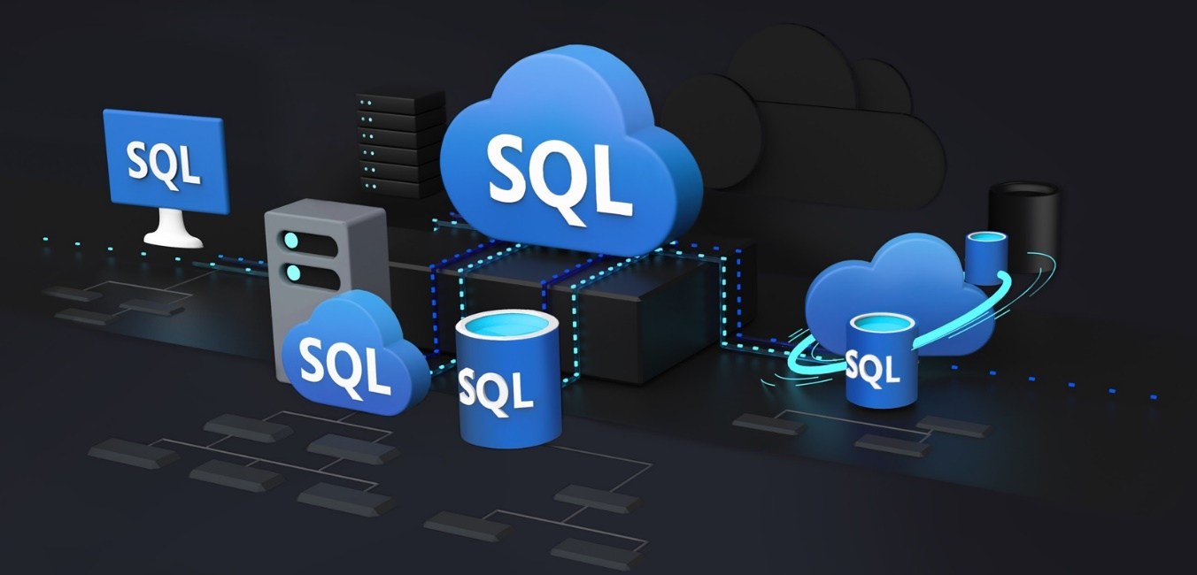
Modern database requirements
Pay only for what you need, when you need it (serverless)
Support development workflows
JSON and geospatial support by default
Future-proof applications
Azure SQL
Database
API
Application
Solution
Summary
Notes:
Anna
At the end, asks Davide: Can you tell us more about how Azure SQL meets the requirements for our bus app and other modern apps?

Slide 11
Azure SQL Database is the best database for modern apps
Run any workload anywhere on the industry-leading SQL Server engine
Built-in security
Versionless
Apply your current skills
Analytical processing and high-concurrency optimizations
Developer experience
Native geospatial support
Multi-model capabilities (JSON, Graph, Key-Value, XML)
Serverless and Hyperscale
Relational Engine is the backbone of everything
Database
API
Application
Solution
Summary
Notes:
Davide but be brief, pick a few
Anna to ask him to dive deeper into JSON / geospatial

Slide 12
Azure SQL Database supports JSON
Storage, manipulation and creation of JSON documents supported
Built-in functions
ISJSON
JSON_VALUE
JSON_QUERY
OPENHJSON
Transform JSON text to table
[
{
“Number”:”SO43659”,
“Date”:”2011-05-31T00:00:00”
“AccountNumber”:”AW29825”,
“Price”:59.99,
“Quantity”:1
},
{
“Number”:”SO43661”,
“Date”:”2011-06-01T00:00:00”
“AccountNumber”:”AW73565”,
“Price”:24.99,
“Quantity”:3
}
]
Number | Date | Customer | Price | Quantity
SO43659 | 2011-05-31T00:00:00 | MSFT | 59.99 | 1
SO43661 | 2011-06-01T00:00:00 | Nokia | 24.99 | 3
FOR JSON
Formats results set as JSON text
Database
API
Application
Solution
Summary
Notes:
Davide

Slide 13
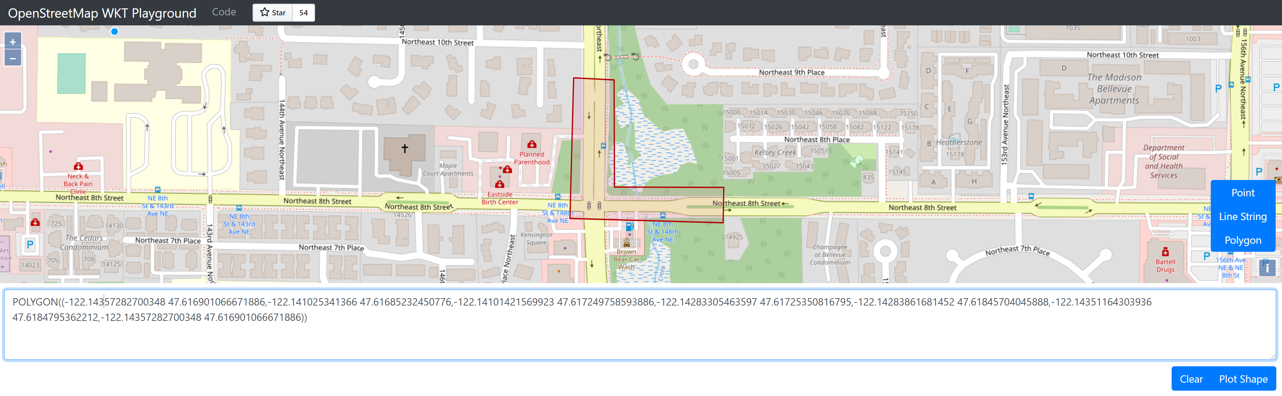
Azure SQL Database supports spatial
Database
API
Application
Solution
Summary
Notes:
Davide

Slide 14
Demo
Deploy and configure Azure SQL Database
Notes:
Anna demo part 1:
Go through module 3 first exercise
Explain Serverless while it’s deploying
Davide demo part 2:
THEN go through notebook 02-json-gepspatial-sql-db.ipynb Parts 1 and 2 only

Slide 15

Deploy and configure Azure SQL Database
Configure your environment
Deploy Azure SQL Database
Use GitHub Actions to configure Azure SQL Database
Import Route Data into Azure SQL Database
Explore JSON and geospatial support
Notes:
Anna demo part 1:
Go through module 3 first exercise
Explain Serverless while it’s deploying
Davide demo part 2:
THEN go through notebook 02-json-gepspatial-sql-db.ipynb Parts 1 and 2 only

Slide 16
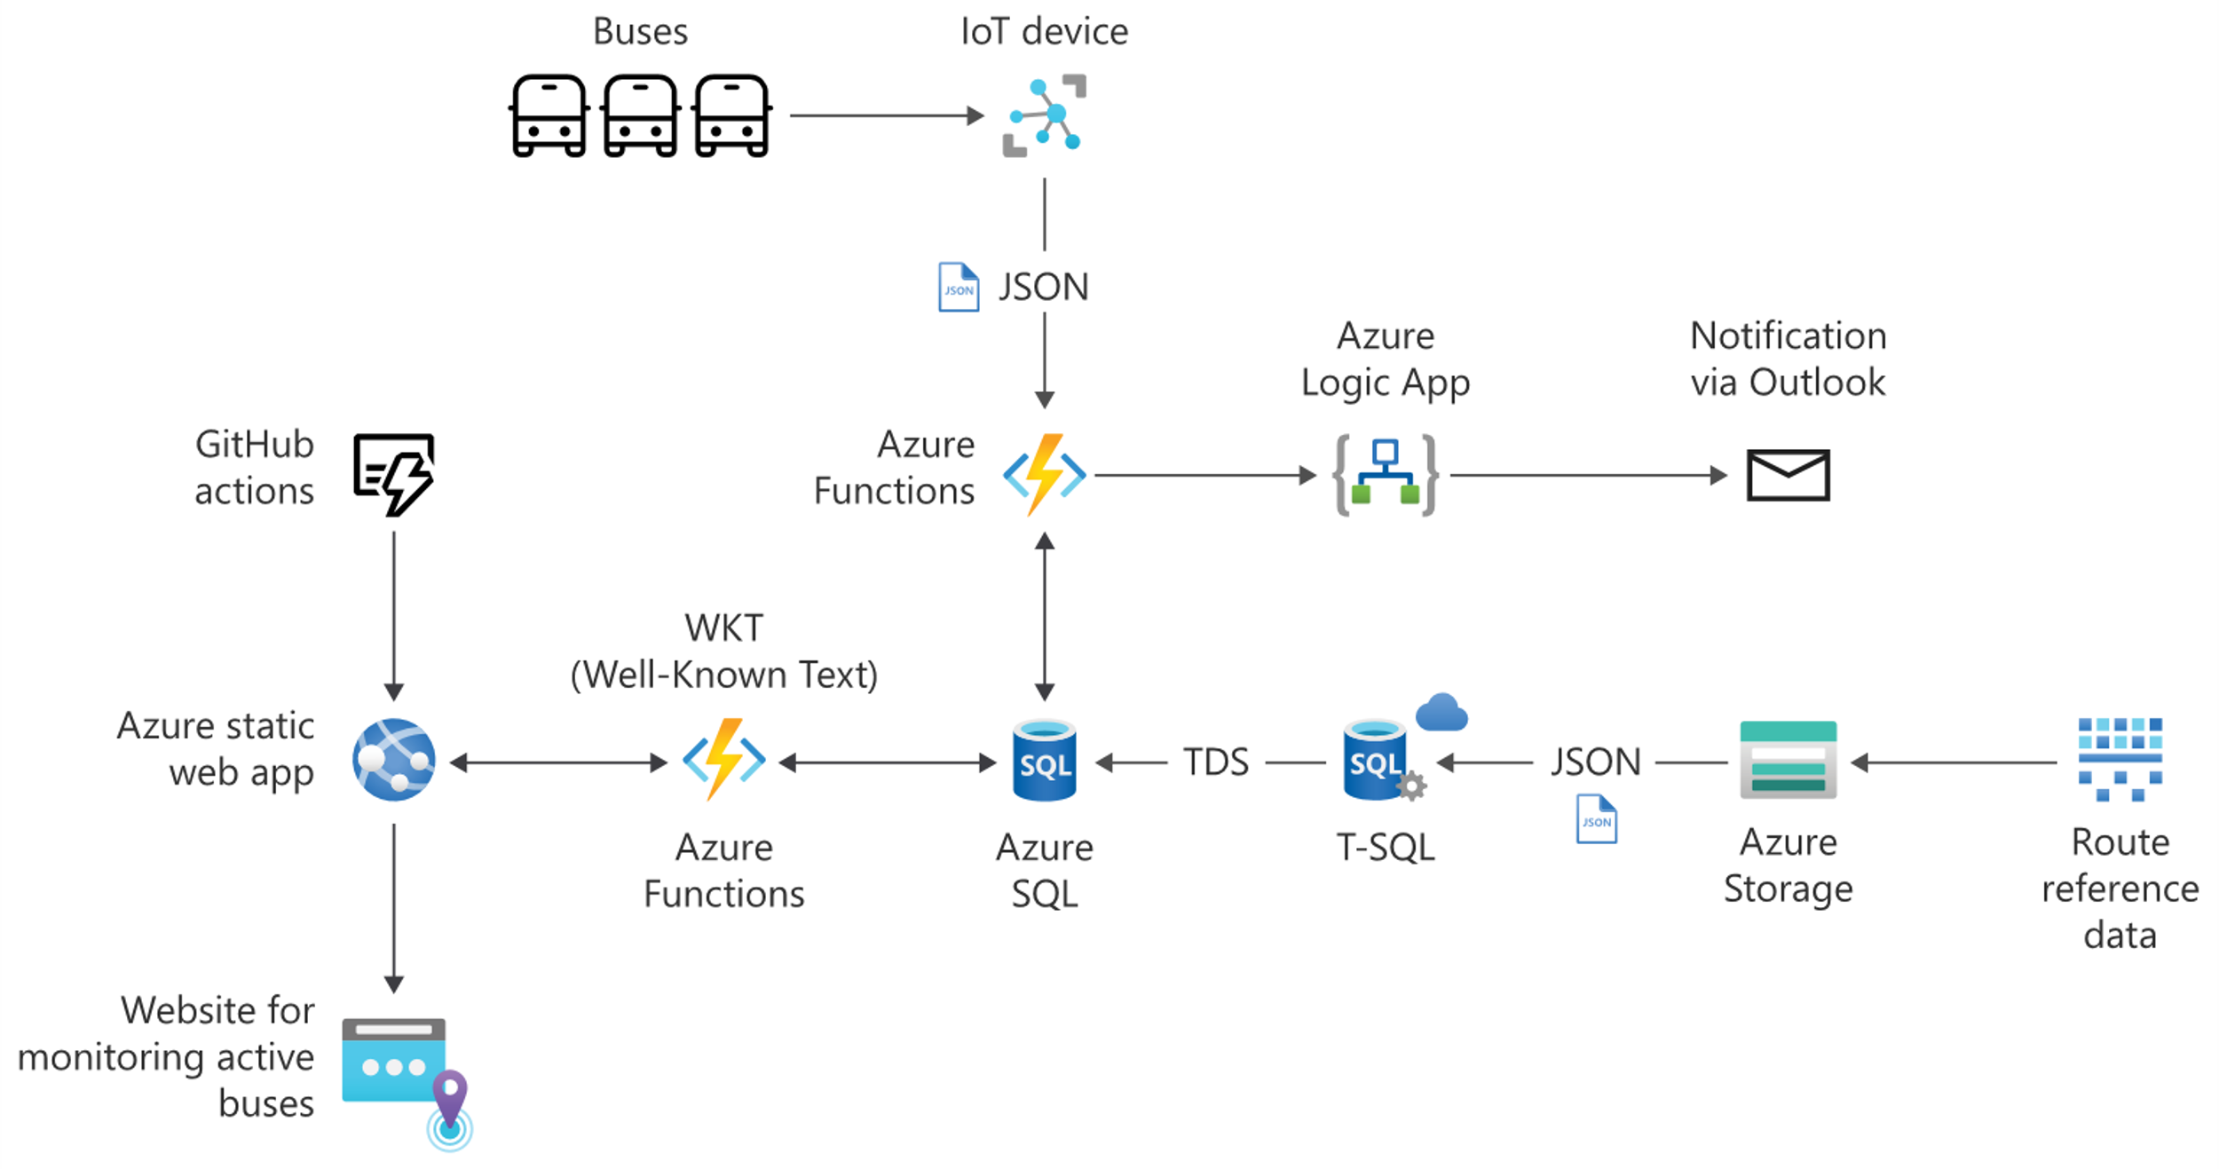

Architecture
Database
API
Application
Solution
Summary
Notes:
Anna explain what we have so far and what the next steps are

Slide 17
Deploy serverless APIs with Azure Functions, Logic Apps, and Azure SQL Database
Module 2
Notes:
Anna

Slide 18
Select an API service
Solution requirements
Website for monitoring real-time bus locations
Notifications when a bus is close by
Deployment automation
API service requirements
Get the latest data and identify buses in monitored routes and geofence activations
Send an email notification for each activated bus
Database
API
Application
Solution
Summary
Notes:
Anna to recap the requirements. Then to ask Davide: What do you think we should use?

Slide 19

Azure Functions
Accelerate and simplify application development
Triggers supported: Queue, Timer, Event Grid, and HTTP
Serverless and scalable
Database
API
Application
Solution
Summary
Notes:
Davide to explain that we might be able to use Azure Functions and explain what Azure Functions are

Slide 20

Catching the bus with Azure Functions
Every 15 seconds, accomplish the following tasks:
Determine what the monitored routes are
Get the latest bus data
Identify buses in monitored routes and activating a geofence
Send an email notification for each activated bus
Database
API
Application
Solution
Summary
Notes:
Davide to explain the different things we’ll use Azure Functions for and the integrations with Azure SQL Database.
At the end, Davide to ask Anna: Finally, we want to send a notification so people know when their bus is closeby and they should head to the bus stop. Have any ideas what we can use for that?

Slide 21

Push notifications with Azure Logic Apps
Low-code/no-code development platform
Serverless cloud service
Automate and orchestrate tasks and workflows
Integrate apps, data, systems, and services
Hundreds of connectors
SQL Server, Azure SQL, Outlook, SMS, file shares
Database
API
Application
Solution
Summary
Notes:
Anna: Well we could probably code something up that connects to Outlook and Azure Functions and then set up an additional endpoint. However, I think Azure Logic Apps is going to be great for this.
Explains Logic Apps. Explains how it will work in the solution

Slide 22
Demo
Configure and deploy Azure Functions
Notes:
Demo how the Azure Functions code works and runs locally – Davide
Demo GitHub Actions Azure Logic Apps / monitor and show incoming emails – Anna

Slide 23
Configure and deploy Azure Functions
Run Azure Functions locally
Configure for CI/CD with GitHub
Push notifications with Azure Logic Apps
Monitor results
Notes:
Demo how the Azure Functions code works and runs locally – Davide
Demo GitHub Actions Azure Logic Apps / monitor and show incoming emails – Anna

Slide 24
Knowledge check
Notes:
Anna to lead and then ask Davide what he thinks the answer is (it is D)

Slide 25
Question 1
Which service(s) will be used to process real-time data and identify if a bus is within a geofence?
Azure Functions
Azure SQL Database
Azure Static Web Apps and Azure Functions
Azure Functions and Azure SQL Database
Notes:
Anna to lead and then ask Davide what he thinks the answer is (it is D)
Explanation: That's correct! Azure Static Web Apps is a combination of a static web app and Azure Functions.

Slide 26
Question 1
Which service(s) will be used to process real-time data and identify if a bus is within a geofence?
Azure Functions
Azure SQL Database
Azure Static Web Apps and Azure Functions
Azure Functions and Azure SQL Database
Notes:
Anna to lead and then ask Davide what he thinks the answer is (it is D)

Slide 27
Architecture
Database
API
Application
Solution
Summary
Notes:
Anna to ask Davide to review the architecture of what we have so far.
Davide: *explains* and ends by talking about how the next step is to have an application

Slide 28
Build full stack applications with Azure Static Web Apps and Azure SQL Database
Module 3
Notes:
Hopefully we’re at the 30-35 min mark here (so it should be around 4PM, otherwise, speed up!)
Anna to exclaim how we’ve reviewed everything and now it’s time to build our web application!

Slide 29
Select an application hosting service
Solution requirements
Website for monitoring real-time bus locations
Notifications when a bus is close by
Deployment automation
Web application requirements
Website displaying a map with real-time buses and geofences
Filter based on bus route(s) and geofence(s)
Database
API
Application
Solution
Summary
Notes:
Anna to recap the solution requirements and web app requirements

Slide 30

Accelerate app development with Azure Static Web Apps
Azure Static Web Apps is a modern web app service that offers streamlined full-stack development from source code to global high availability
Database
API
Application
Solution
Summary
Notes:
Anna to explain what Azure Static Web Apps is. It’s been selected as the best option for our app. Let’s explore why.
Davide, can you tell us what languages static web apps support and if that’s good enough for our scenario?

Slide 31





Static web apps
Static web apps are commonly built using libraries and frameworks like Angular, React, Svelte, Vue, or Blazor where server side rendering is not required.
Database
API
Application
Solution
Summary
Notes:
Davide to explain

Slide 32

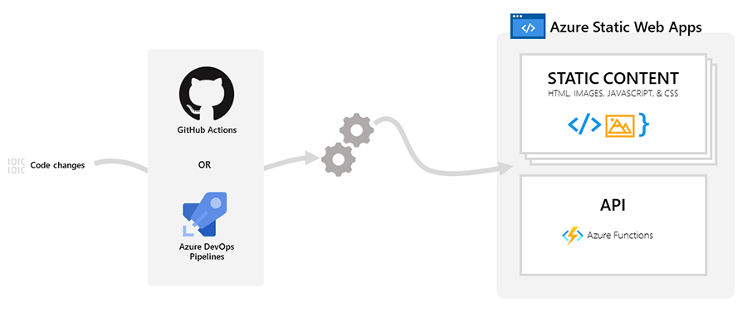
Azure Static Web Apps
+
Combine the power of static web apps with Azure Functions
Database
API
Application
Solution
Summary
Notes:
Davide to start by talking about how Azure Static Web Apps combines static web application hosting and Azure Functions
Davide to ask Anna if there’s support for GitHub automation like we’ve seen with Azure Functions and Azure SQL Database?
Anna to answer and explain how it works with diagram.

Slide 33

GitHub Actions and Azure Static Web Apps
yaml
- name: Build And Deploy
id: builddeploy
uses: Azure/static-web-apps-deploy@v0.0.1-preview
with:
azure_static_web_apps_api_token: ${{ secrets.AZURE_STATIC_WEB_APPS_API_TOKEN }}
repo_token: ${{ secrets.GITHUB_TOKEN }}
action: "upload"
app_location: "azure-static-web-app/client"
api_location: "azure-static-web-app/api"
output_location: ".github/workflows"
Database
API
Application
Solution
Summary
Notes:
Anna

Slide 34
Knowledge check
Notes:
Anna to lead and then ask Davide what he thinks the answer is (D)

Slide 35
Question 2
What is the main value proposition of Azure Static Web Apps?
Scalable cloud service for web apps that require server-side rendering
Variation of Azure Functions, which supports Angular and React
Combination of Azure Functions and Azure SQL Database
Combination of static web apps and serverless APIs
Notes:
Anna to lead and then ask Davide what he thinks the answer is (D)
Explanation: That's correct! Azure Static Web Apps is a combination of a static web app and Azure Functions.

Slide 36
Question 2
What is the main value proposition of Azure Static Web Apps?
Scalable cloud service for web apps that require server-side rendering
Variation of Azure Functions, which supports Angular and React
Combination of Azure Functions and Azure SQL Database
Combination of static web apps and serverless APIs
Notes:
Anna to lead and then ask Davide what he thinks the answer is (D)
Explanation: That's correct! Azure Static Web Apps is a combination of a static web app and Azure Functions.

Slide 37
Question 3
What information is contained in the GitHub workflow file for an Azure Static Web App?
App location and API location in the repository
App location, API location, and secrets stored in plain text
App location, API location, and references to secrets
App location, API location, and subscription ID
Notes:
Anna to lead and then ask Davide what the answer is ©
Explanation: Correct! Secrets are stored in the repository, but not in plain text in the workflow file.

Slide 38
Question 3
What information is contained in the GitHub workflow file for an Azure Static Web App?
App location and API location in the repository
App location, API location, and secrets stored in plain text
App location, API location, and references to secrets
App location, API location, and subscription ID
Notes:
Anna to lead and then ask Davide what the answer is ©
Explanation: Correct! Secrets are stored in the repository, but not in plain text in the workflow file.

Slide 39
Demo
Deploy an Azure Static Web App
Notes:
Anna to show in portal but also flash up that you can do it with commands

Slide 40
Deploy an Azure Static Web App
Deploy an Azure Static Web App
Notes:
Anna to show in portal but also flash up that you can do it with commands

Slide 41
Accessing data from Azure Static Web Apps

Slide 42

Accessing data from Azure Static Web Apps
Often, a database is required to obtain, process, and serve data related to the application.
Client UI
Backend API
Azure SQL
JSON
JSON
JSON
JSON
Client UI
Backend API
Azure SQL
Database
API
Application
Solution
Summary
Notes:
Anna to start to explain but then ask David how it works for Azure SQL for the front end?

Slide 43
Access data for the front end
The front end, a static web page, has been created with a popular framework Vue.js.
javascript
$.getJSON(apiUrl, function (data) {
plotWKT(data);
});
const params = new URLSearchParams(location.search);
const rid = params.get('rid');
const gid = params.get('gid');
const apiUrl = `/api/bus-data?rid=${rid}&gid=${gid}`;
Database
API
Application
Solution
Summary
Notes:
NOTE THIS ANIMATES, two code blocks!
Davide

Slide 44
javascript
javascript
function plotWKT(data) {
var f1, f2;
if (data.busData == [] || data.geoFence == [])
return;
try {
f1 = format.readFeature(data.geoFence);
f2 = format.readFeature(data.busData);
} catch (err) { }
features.clear();
// geoFence
if (f1)
{
f1.getGeometry().transform('EPSG:4326', 'EPSG:3857’);
features.push(f1);
}
// busData
if (f2)
{
f2.getGeometry().transform('EPSG:4326', 'EPSG:3857’);
features.push(f2);
}
...
Notes:
The front end, a static web page, has been created with a popular framework Vue.js. It's a simple application with goals to display a map, real-time bus data points, and geofence(s).
[!NOTE] The code created was inspired by https://github.com/clydedacruz/openstreetmap-wkt-playground
In this application, an important part is getting the route ID and geofence ID parameters that will be passed through the URL via the rid and gid URL parameters.
const params = new URLSearchParams(location.search); const rid = params.get('rid'); const gid = params.get('gid'); const apiUrl = `/api/bus-data?rid=${rid}&gid=${gid}`;
After that, it's easy to call the apiUrl that calls the Azure Function that fetches the corresponding bus and geofence data from Azure SQL Database to be displayed in real time.
$.getJSON(apiUrl, function (data) { plotWKT(data); }); }
Once the data is returned in Well-Known Text (WKT) format, the function plotWKT simply gathers data.geoFence and data.busData and plots them accordingly. Part of that function is shown below.
function plotWKT(data) { var f1, f2; if (data.busData == [] || data.geoFence == []) return; try { f1 = format.readFeature(data.geoFence); f2 = format.readFeature(data.busData); } catch (err) { } features.clear(); // geoFence if (f1) { f1.getGeometry().transform('EPSG:4326', 'EPSG:3857'); features.push(f1); } // busData if (f2) { f2.getGeometry().transform('EPSG:4326', 'EPSG:3857'); features.push(f2); } ...

Slide 45

Access Azure SQL Database for the back end
The front end essentially calls the API to return all the necessary data.
Client UI
Backend API
Azure SQL
JSON
JSON
JSON
JSON
Client UI
Backend API
Azure SQL
Database
API
Application
Solution
Summary
Notes:
Anna.
At the end, to ask Davide: Davide, we built this sample using several different languages. Can you tell folks some of the things to consider when connecting to Azure SQL Database from applications?

Slide 46
Create a connection to Azure SQL Database
.NET → Microsoft.Data.SqlClient
Python → pyodbc
Node.js → mssql
C#
Server=tcp:[serverName].database.windows.net,1433;Database=bus-db;User ID=[userId];Password=[yourPassword];Encrypt=true;Connection Timeout=30;
Python
Driver={ODBC Driver 17 for SQL Server};Server=[serverName].database.windows.net,1433; Database=bus-db;UID=[userId];PWD=[yourPassword];Connection Timeout=30;
Node.js
mssql://[userId]:[yourPassword]@[serverName].database.windows.net/bus-db?encrypt=true
Database
API
Application
Solution
Summary
Notes:
Davide to explain and share any tips and tricks about the libraries or connecting

Slide 47

Return the real-time bus data to the application
The stored procedure web.GetMonitoredBusData returns the real-time bus data in JSON format
This way is super easy to consume it!
{
“busData”: “MULTIPOINT ((-122.143341 47.661), … (-122.132492 47.617))”
“geoFence”: “POLYGON ((-122.14359028995352 47.618245191, … , -122.14359028995352 47.618245191))”
}
Database
API
Application
Solution
Summary
Notes:
Anna: Cool thanks Davide. Yeah and once you’re connected it’s really just a matter of calling the stored procedure that returns the data to surface in the app!

Slide 48
Knowledge check
Notes:
Anna to lead and then ask Davide what he thinks the answer is

Slide 49
Question 4
What do the rid and gid parameters represent?
rid and gid represent the specific route and geofence to be displayed on the map
rid and gid represent the specific route and group of buses to be displayed on the map
rid and gid represent all the routes and geofences
rid and gid represent all the routes and groups of buses
Notes:
Anna to lead and then ask Davide what he thinks the answer is

Slide 50
Question 4
What do the rid and gid parameters represent?
rid and gid represent the specific route and geofence to be displayed on the map
rid and gid represent the specific route and group of buses to be displayed on the map
rid and gid represent all the routes and geofences
rid and gid represent all the routes and groups of buses
Notes:
Anna to lead and then ask Davide what he thinks the answer is

Slide 51
Question 5
What is the order of serving data to the front end?
The client application obtains the parameters and passes them to Azure SQL Database, which returns the relevant data to the Azure Function.
The Azure Function obtains the parameters and passes them to the client application, then the client application gets the relevant data from Azure SQL Database and displays it in the client application.
The client application obtains the parameters and passes them to the Azure Function, then the Azure Function gets the relevant data from Azure SQL Database and returns it to the client application.
Azure SQL Database obtains the parameters and passes them to the Azure Function, then the Azure Function gets the relevant data from the client application and returns it to Azure SQL Database.
Notes:
Anna to lead and then ask Davide what he thinks the answer is

Slide 52
Question 5
What is the order of serving data to the front end?
The client application obtains the parameters and passes them to Azure SQL Database, which returns the relevant data to the Azure Function.
The Azure Function obtains the parameters and passes them to the client application, then the client application gets the relevant data from Azure SQL Database and displays it in the client application.
The client application obtains the parameters and passes them to the Azure Function, then the Azure Function gets the relevant data from Azure SQL Database and returns it to the client application.
Azure SQL Database obtains the parameters and passes them to the Azure Function, then the Azure Function gets the relevant data from the client application and returns it to Azure SQL Database.
Notes:
Anna to lead and then ask Davide what he thinks the answer is

Slide 53
Demo
Configure Azure Static Web Apps and monitor the solution
Notes:
Anna to revisit application (configure azure sql connection strings) and show Davide final solution
Then review github actions

Slide 54
Configure Azure Static Web Apps and monitor the solution
Configure application settings
View the published bus-app
Review the GitHub Action runs
Notes:
Anna to revisit application (configure azure sql connection strings) and show Davide final solution
Then review github actions
Anna to Review what we did then ask Davide: Davide, we’ve seen a lot of services but I think we can finally put together the solution. Can you take us through it?

Slide 55
Solution architecture
Database
API
Application
Solution
Summary
Notes:
Davide to review the entire architecture’s solution
Let's review a possible architecture that would support the challenges and goals discussed.
The architecture uses several different services to minimize the amount of code you need to write, and to take advantage of the scalability and infrastructure benefits provided by Azure.

Slide 56
Summary

Slide 57
Summary
In the language of your choice (Node.js, Python, or .NET), we used an Azure Function that's built-in to an Azure Static Web App to get the data for specific bus routes and geofences. The Azure Static Web App was then used to surface the map on a website.
You learned how to design APIs in any language and integrate them with Azure SQL Database and Azure Static Web Apps
You learned how to create Vue.js web applications using Azure Static Web Apps
You also learned how Visual Studio Code, the Azure portal, and GitHub are integrated to give you an efficient and seamless way to maintain CI/CD with GitHub Actions.
Database
API
Application
Solution
Summary
Notes:
Anna

Slide 58
Resources
Try the whole learning path https://aka.ms/AzureModernApps
Watch our show https://aka.ms/azuresqlyt
Follow us on twitter to stay up to date @AzureSQL
We wrote a book! https://aka.ms/azuresqlfordevelopers
Database
API
Application
Solution
Summary
Notes:
Anna but to end by asking Davide about the book

Slide 59



Join us weekly on Learn TV.
https://aka.ms/azuresqlyt
Notes:
Anna to present this one and then Davide to wrap by thanking attendees and telling them to enjoy the rest of Microsoft Build
Again thank you all for joining us today at these Learn Live at Build Sessions.
But as they say, "that's not all".
If you enjoyed this session today, we hope you come back for Learn Live every week. Each episode will cover a Learn Module and work with experts to cover the Learn content in depth, with live Q & A.
With over 2,000 topics in Microsoft Learn, we will be covering all manner of things going forward.
Learn Live airs every Monday on Learn TV, so mark your calendars, and come join in.

Slide 60
End slide

